Slide 1
Asymptotic Analysis of American Options, A Free Boundary Value Problem
John Lee
4/25/2024

Slide 2
Introduction

Slide 3
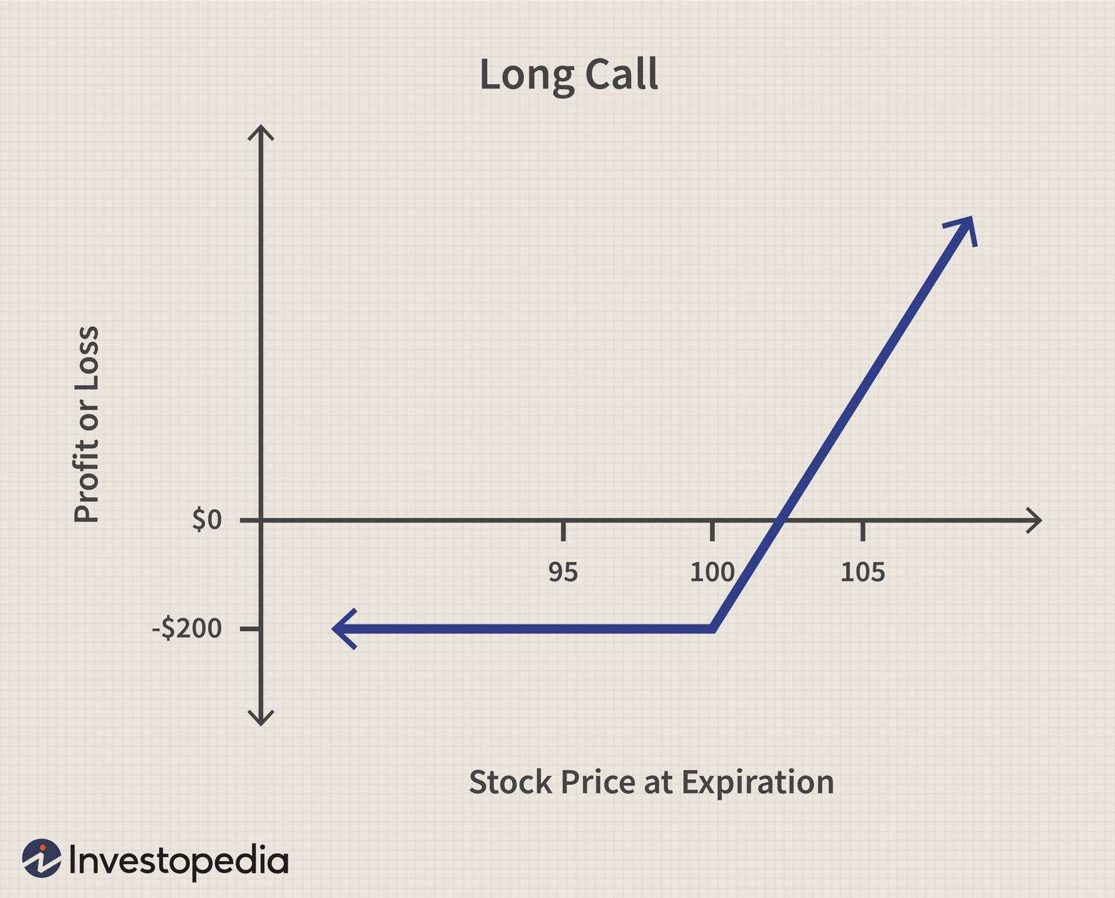

What are options?
Call/Put Options
Financial Derivative
Gives you the right to buy/sell an underlying asset (ex. stocks) at a strike price K.
Exercised at time T if profitable or expires worthless
Priced by time value (TV) + intrinsic value (IV)
Intrinsic Value ($S−K$)
If you exercised the option and received stock for $\$K$ sold it for $\$S$ immediately, how much do you make

Slide 4


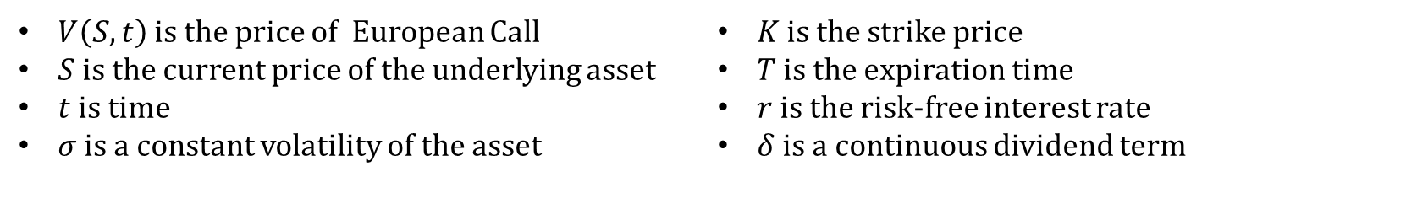
How to Price Options (Black Scholes PDE)
According to PDE (modified for dividends):
$$\frac{∂V}{∂t}+\frac{1}{2}σ^{2}S^{2}\frac{∂^{2}V}{∂S^{2}}+\left(r−δ\right)S\frac{∂V}{∂S}−rV=0$$
$$V\left(0, t\right)=0$$
$$V\left(∞, t\right)=Se^{−δ(T−t)}−Ke^{−r(T−t)}$$
$$V\left(S, T\right)=\max\left(S−K, 0\right)$$
Closed Form Solution:
$$V\left(S, t\right)=Se^{−δ(T−t)}N\left(d_{1}\right)−Ke^{−r\left(T−t\right)}N(d_{2})$$
$$d_{1}=\frac{\ln\left(\frac{S}{K}\right)+\left(r−δ+\frac{σ}{2}\right)t}{σ\sqrt{t}}$$
$$d_{2}=d_{1}−σ\sqrt{t}$$
$V\left(S, t\right)$ is the price of European Call
$S$ is the current price of the underlying asset
$t$ is time
$σ$ is a constant volatility of the asset
$K$ is the strike price
$T$ is the expiration time
$r$ is the risk-free interest rate
$δ$ is a continuous dividend term

Slide 5
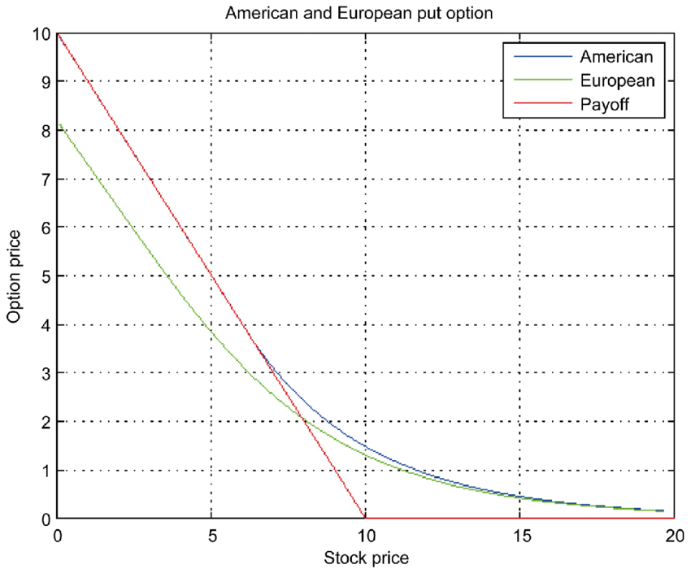

American vs. European Options
European: Can only exercise this right at expiration T.
American: Can be exercised prior to time T, sacrificing time value.
Can prevent option from falling below intrinsic value $S−K$

Slide 6

American Options as Free Boundary Value Problem
Free Boundary Value Problems
A class of PDE problems with two unknowns, $u$ and $Ω$
$Ω$ is the domain of $u$
Mathematically challenging because $Ω$ depends on the parameters of $u$ and must be solved simultaneously
European Options
$$u=V\left(S, t\right), Ω:\left(S, t\right)∈\left(0,∞\right) ×[0,T]$$
American options (for calls)
$$u=V\left(S, t\right), Ω:\left(S, t\right)∈\left(0,?\right) ×[0,?]$$

Slide 7
The Optimal Exercise Boundary

Slide 8
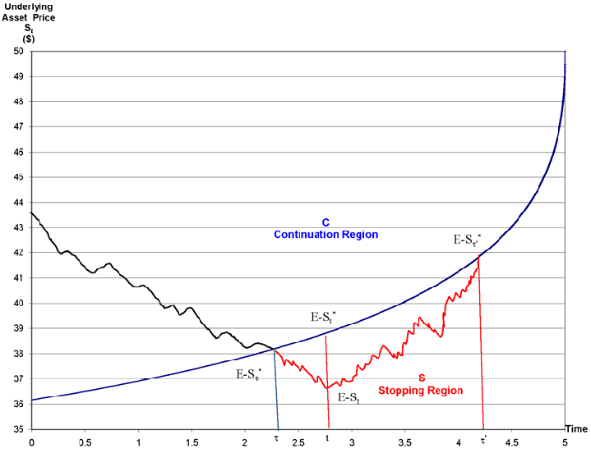

Optimal Exercise Boundary
There exists a function over time that determines when an American option should be exercised.
$$S_{P|C}^{∗}\left(τ\right), τ=T −t$$
Continuation Region
Pricing follows PDE
Stopping Region
Free boundary is hit and option would have been exercised

Slide 9

An Economic Perspective for Early Exercise
Call Options
Early exercise when dividend earned over remaining time > time premium lost
$S_{C}^{∗}$ does not exist for non-dividend paying assets
Put Options
Early exercise when the money reinvested in a risk-free asset earning interest over remaining time > time premium lost
$S_{P}^{∗}$ exists for any $r>0$

Slide 10
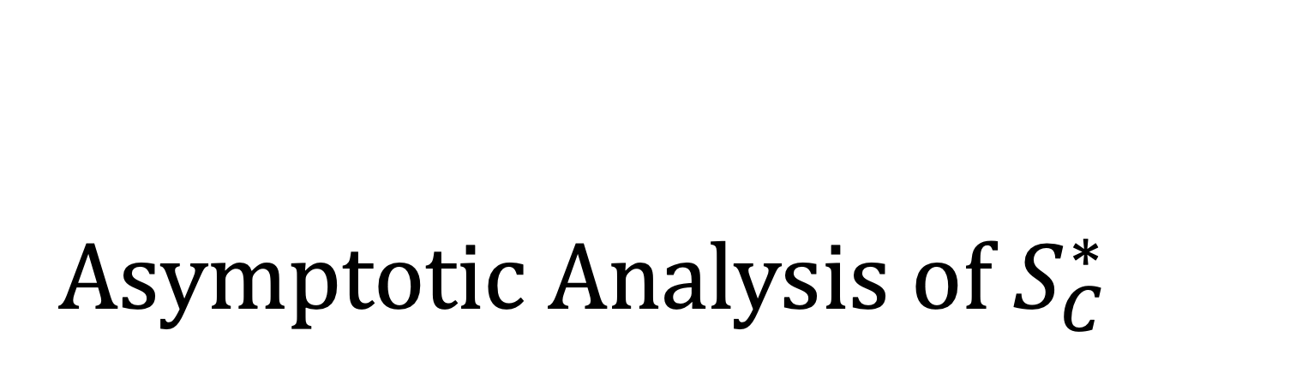
Asymptotic Analysis of $S_{C}^{∗}$

Slide 11


Property Analysis of $S_{C}^{∗}$
Closed Form Solution:
$$V\left(S, t\right)=Se^{−δ(T−t)}N\left(d_{1}\right)−Ke^{−r\left(T−t\right)}N(d_{2})$$
$$d_{1}=\frac{\ln\left(\frac{S}{K}\right)+\left(r−δ+\frac{σ}{2}\right)t}{σ\sqrt{t}}$$
$$d_{2}=d_{1}−σ\sqrt{t}$$

Slide 12


Property Analysis of $S_{C}^{∗}$
Suppose $S≫K$
We then have
$$N\left(d_{1}\right) \sim 1,N\left(d_{2}\right) \sim 1$$
Substituting into the close form solution, we get
$$C\left(S,t\right)=Se^{−δ(T−t)}−Ke^{−r\left(T−t\right)}$$
The $e^{−δ(T−t)}$ term possibly allows the option to fall below intrinsic value ($S−K$)
An ACO holder would not allow their option to fall below ($S−K$)
$$C\left(S, t\right)=Se^{−δ(T−t)}N\left(d_{1}\right)−Ke^{−r\left(T−t\right)}N(d_{2})$$
$$d_{1}=\frac{\ln\left(\frac{S}{K}\right)+\left(r−δ+\frac{σ}{2}\right)t}{σ\sqrt{t}}$$
$$d_{2}=d_{1}−σ\sqrt{t}$$

Slide 13
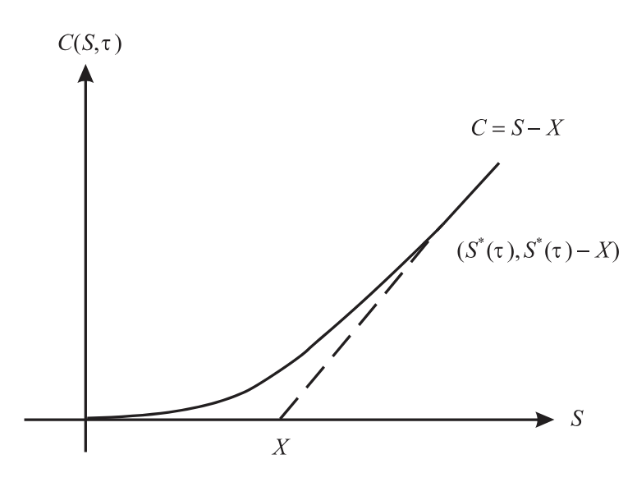

Property Analysis of $S_{C}^{∗}$
Property 1
For $S≥S^{∗}\left(τ\right)$, the option is exercised and $C\left(S,τ\right)=S−K$ is a lower bound for our call option
Continuation Region:
$$\{\left(S,τ\right):0<S<S^{∗}, 0<τ<T\}$$

Slide 14
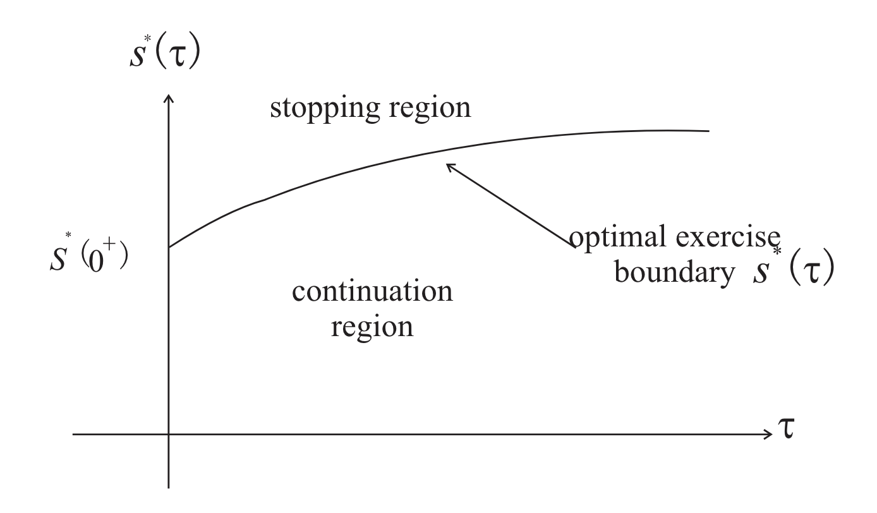
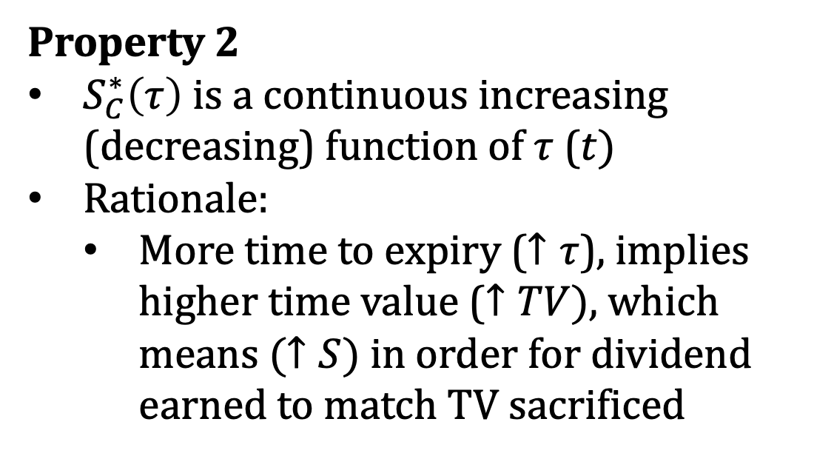
Property Analysis of $S_{C}^{∗}$
Property 2
$S_{C}^{∗}\left(τ\right)$ is a continuous increasing (decreasing) function of $τ$ ($t)$
Rationale:
More time to expiry ($↑τ$), implies higher time value ($↑TV)$, which means $(↑S)$ in order for dividend earned to match TV sacrificed

Slide 15



$S_{C}^{∗}$ close to expiry ($τ→0^{+})$
PDE (modified for dividends):
$$\frac{∂V}{∂t}+\frac{1}{2}σ^{2}S^{2}\frac{∂^{2}V}{∂S^{2}}+\left(r−δ\right)S\frac{∂V}{∂S}−rV=0$$
$$V\left(0, t\right)=0$$
$$V\left(∞, t\right)=Se^{−δ(T−t)}−Ke^{−r(T−t)}$$
$$V\left(S, T\right)=\max\left(S−K, 0\right)$$
PDE (modified for $τ$ and $C\left(S, τ\right)$ and ACO)
$$−\frac{∂C}{∂τ}+\frac{1}{2}σ^{2}S^{2}\frac{∂^{2}C}{∂S^{2}}+\left(r−δ\right)S\frac{∂C}{∂S}−rC=0$$
$$C\left(0, τ\right)=0$$
$$C\left(S_{C}^{∗}(τ), τ\right)=S−K$$
$$C\left(S, 0\right)=\max\left(S−K, 0\right)$$

Slide 16
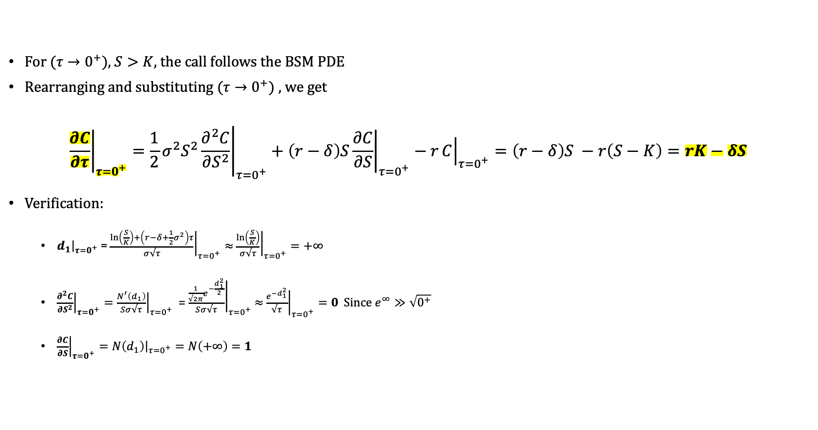
$S_{C}^{∗}$ close to expiry ($τ→0^{+})$
For ($τ→0^{+})$, $S>K$, the call follows the BSM PDE
Rearranging and substituting ($τ→0^{+})$, we get
$${\left.\frac{∂C}{∂τ}\right|}_{τ=0^{+}}=\frac{1}{2}σ^{2}S^{2}{\left.\frac{∂^{2}C}{∂S^{2}}\right|}_{τ=0^{+}}+{\left(r−δ\right)S\left.\frac{∂C}{∂S}\right|}_{τ=0^{+}}−r{\left.C\right|}_{τ=0^{+}}=\left(r−δ\right)S −r\left(S−K\right)=rK−δS$$
Verification:
${\left.d_{1}\right|}_{τ=0^{+}}$ = ${\left.\frac{\ln\left(\frac{S}{K}\right)+\left(r−δ+\frac{1}{2}σ^{2}\right)τ}{σ√τ}\right|}_{τ=0^{+}}≈$ ${\left.\frac{\ln\left(\frac{S}{K}\right)}{σ√τ}\right|}_{τ=0^{+}}=+∞$
${\left.\frac{∂^{2}C}{∂S^{2}}\right|}_{τ=0^{+}}={\left.\frac{N^{′}\left(d_{1}\right)}{Sσ√τ}\right|}_{τ=0^{+}}$ = ${\left.\frac{\frac{1}{√2π}e^{−\frac{d_{1}^{2}}{2}}}{Sσ√τ}\right|}_{τ=0^{+}}$ $≈$ ${\left.\frac{e^{−d_{1}^{2}}}{√τ}\right|}_{τ=0^{+}}=0$ Since $e^{∞}≫\sqrt{0^{+}}$
${\left.\frac{∂C}{∂S}\right|}_{τ=0^{+}}={\left.N\left(d_{1}\right)\right|}_{τ=0^{+}}=N\left(+∞\right)=1$

Slide 17

$S_{C}^{∗}$ close to expiry ($τ→0^{+})$
$$\frac{∂C}{∂τ}\left(S, 0^{+}\right)=rK−δS$$
If we were looking at equilibrium, we expect $\frac{∂C}{∂τ}\left(S, 0^{+}\right)$ = 0. Still important but not the case here.
$\frac{∂C}{∂τ}\left(S, 0^{+}\right)<0$
A contradiction arises as $C\left(S,τ\right)<C\left(S, 0^{+}\right)= S −K$ immediately prior to expiration. We know the ACO would have already been exercised.
Thus $\frac{∂C}{∂τ}\left(S, 0^{+}\right)≥0$ for ACO to stay alive.
Furthermore, Sign change occurs at
$$S=\frac{rK}{δ}$$

Slide 18

$S_{C}^{∗}$ close to expiry ($τ→0^{+})$
$$S=\frac{rK}{δ}$$
$δ<r$
For some small time interval $Δt$ before expiry, $δSΔt<rKΔt$, implying that the dividend earned from holding asset is less than the interest invested in a risk-free asset (or you can think of it as the expected increase S over $Δt$)
Therefore the ACO is alive and allows us to draw these two conclusions
$$S<\frac{rK}{δ} →\frac{∂C}{∂τ}\left(S, 0^{+}\right)>0 \& S>\frac{rK}{δ}→\frac{∂C}{∂τ}\left(S, 0^{+}\right)<0$$
Thus the point of sign change is our optimal exercise value,
$$S_{C}^{∗}\left(0^{+}\right)=\frac{rK}{δ}$$
Aside: as ($δ→0^{+})$, $S_{C}^{∗}\left(0^{+}\right)→ +∞$ and $S_{C}^{∗}(τ)$ is increasing, which follows the reasoning that there is no optimal exercise price for a ACO on a non-dividend paying asset.

Slide 19

$S_{C}^{∗}$ close to expiry ($τ→0^{+})$
$$S=\frac{rK}{δ}$$
$δ≥r$
Proof by Contradiction:
Suppose $S_{C}^{∗}\left(0^{+}\right)>K$ so the ACO is alive, which implies $S_{C}^{∗}>S>K$ close to expiry
If $δ≥r$ & $S>K$, for some $Δt$ before expiry, $δSΔt>rKΔt$
This, however, implies dividend earned from holding asset is greater than the interest invested in a risk-free asset
$∴S_{C}^{∗}\left(0^{+}\right)≤K$
Since $S_{C}^{∗}\left(0^{+}\right)≤K$, $S_{C}^{∗}\left(τ\right)≥K$ and $S_{C}^{∗}\left(τ\right)$ is increasing, we must have
$$S_{C}^{∗}\left(0^{+}\right)=K$$

Slide 20
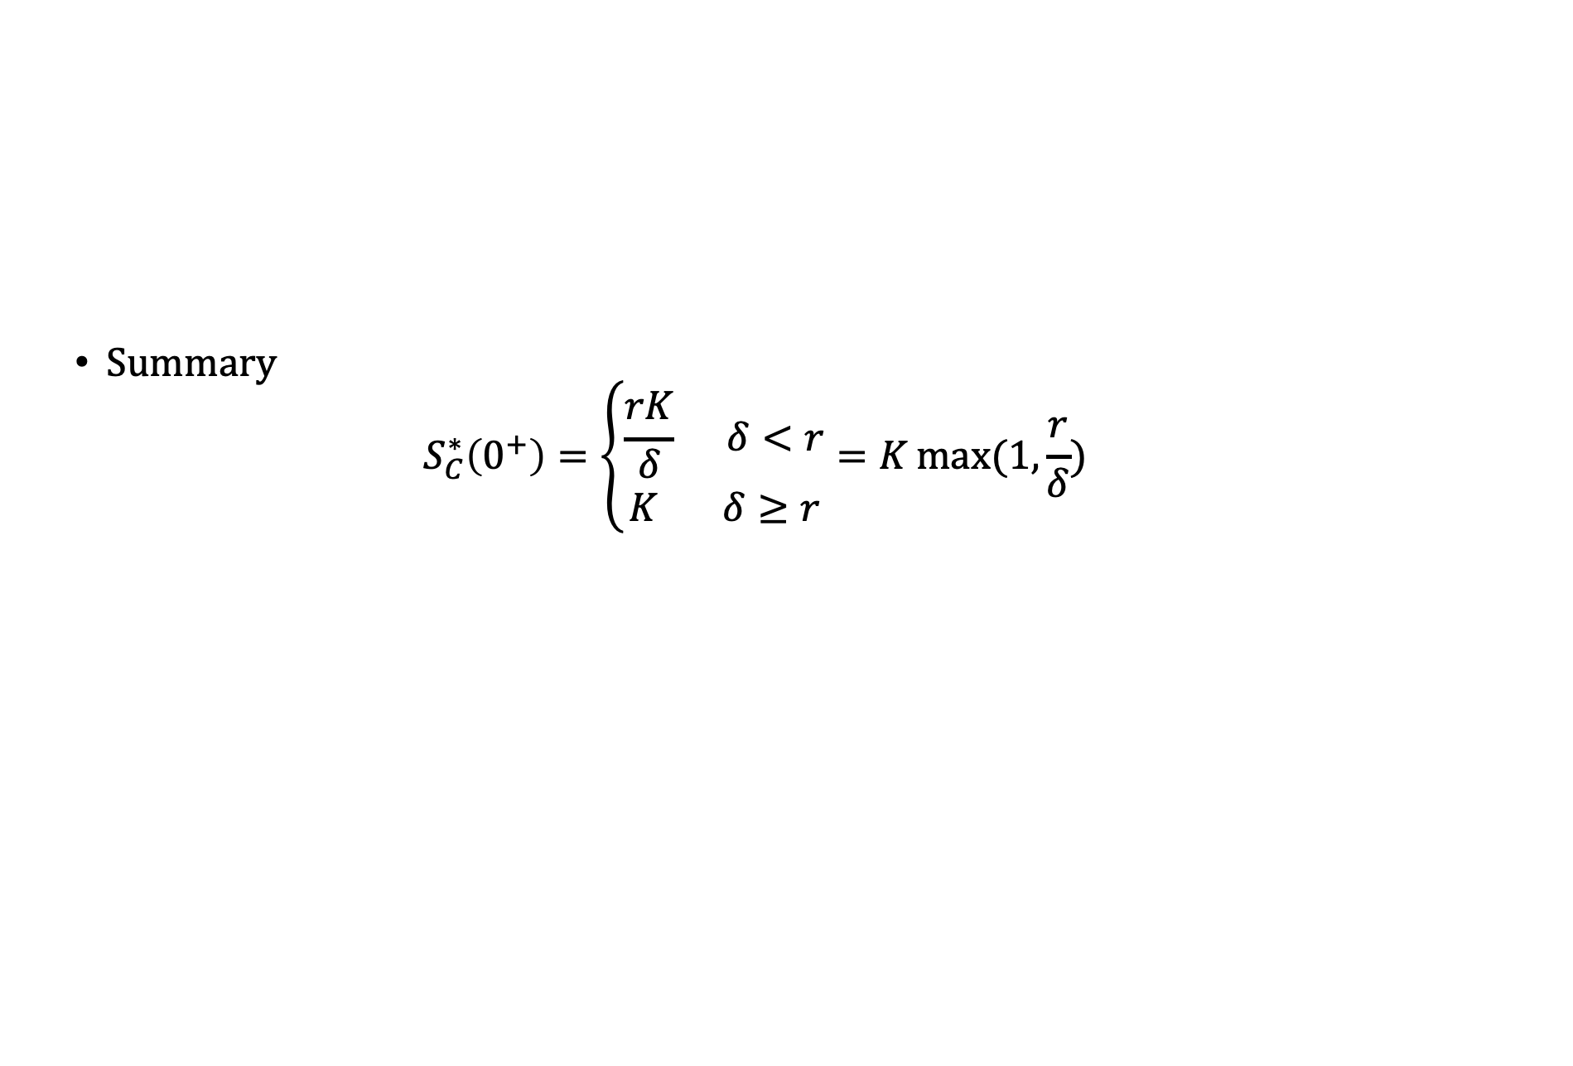
$S_{C}^{∗}$ close to expiry ($τ→0^{+})$
Summary
$$S_{C}^{∗}\left(0^{+}\right)=\left\{\begin{aligned}\frac{rK}{δ} δ<r \\ K δ≥r\end{aligned}\right.=K\max{(1,\frac{r}{δ})}$$

Slide 21
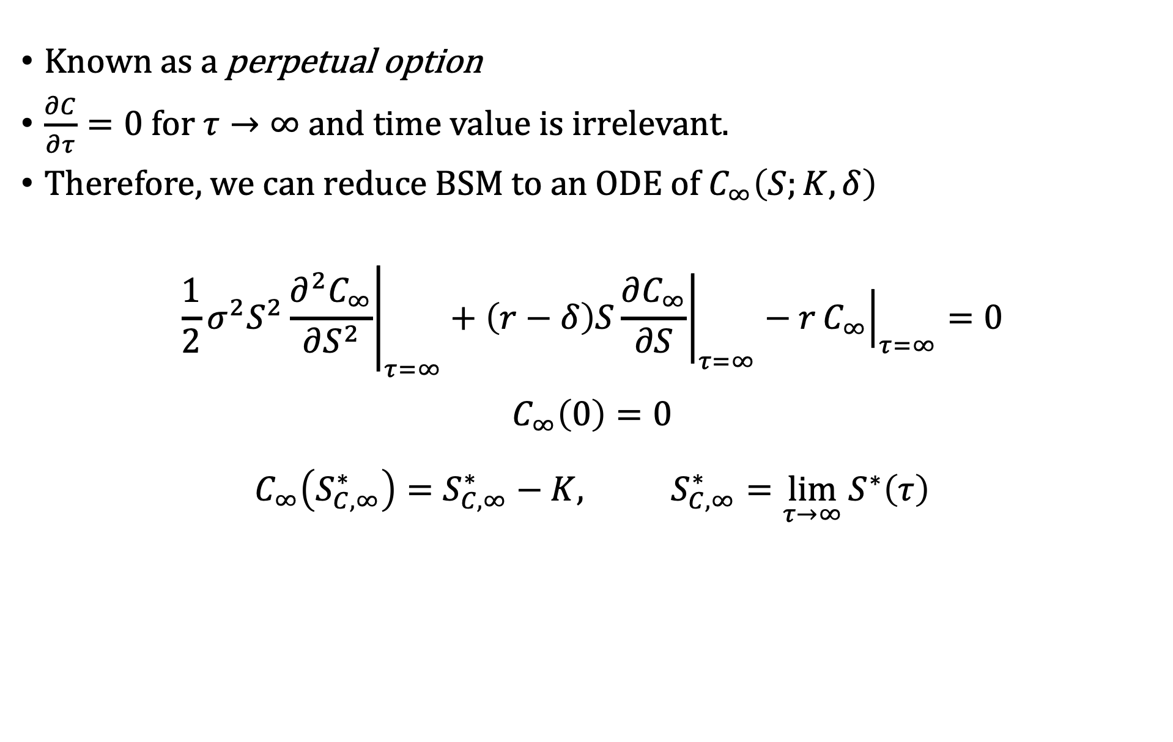

$S_{C}^{∗}$ infinite time to expiry ($τ→∞)$
Known as a perpetual option
$\frac{∂C}{∂τ}=0$ for $τ→∞$ and time value is irrelevant.
Therefore, we can reduce BSM to an ODE of $C_{∞}\left(S;K,δ\right)$
$$\frac{1}{2}σ^{2}S^{2}{\left.\frac{∂^{2}C_{∞}}{∂S^{2}}\right|}_{τ=∞}+{\left(r−δ\right)S\left.\frac{∂C_{∞}}{∂S}\right|}_{τ=∞}−r{\left.C_{∞}\right|}_{τ=∞}=0$$
$$C_{∞}\left(0\right)=0$$
$$C_{∞}\left(S_{C, ∞}^{∗}\right)=S_{C,∞}^{∗}−K, S_{C,∞}^{∗}=\lim_{τ→∞}{S^{∗}\left(τ\right)}$$

Slide 22

$S_{C}^{∗}$ infinite time to expiry ($τ→∞)$
Given the ODE
$$\frac{1}{2}σ^{2}S^{2}\frac{∂^{2}C_{∞}}{∂S^{2}}+\left(r−δ\right)S\frac{∂C_{∞}}{∂S}−rC_{∞}=0$$
$$C_{∞}\left(0\right)=0$$
$$C_{∞}\left(S_{C, ∞}^{∗}\right)=S_{C,∞}^{∗}−K, S_{C,∞}^{∗}=\lim_{τ→∞}{S^{∗}\left(τ\right)}$$
We apply the ansatz $f\left(S\right)=S^{λ}$, with $f^{′}=λS^{λ−1}$ and $f^{′′}=λ{\left(λ−1\right)S}^{λ−2}$ and substitute into the ODE to get
$$\frac{1}{2}σ^{2}S^{2}λ{\left(λ−1\right)S}^{λ−2}+\left(r−δ\right)SλS^{λ−1}−rS^{λ}=0$$
$$S^{λ}\left[\frac{1}{2}σ^{2}λ\left(λ−1\right)+\left(r−δ\right)λ −r\right]=S^{λ}\left[\frac{1}{2}σ^{2}λ^{2}+\left(r−δ−\frac{1}{2}σ^{2}\right)λ −r\right]=0$$

Slide 23

$S_{C}^{∗}$ infinite time to expiry ($τ→∞)$
$$\left[\frac{1}{2}σ^{2}λ^{2}+\left(r−δ−\frac{1}{2}σ^{2}\right)λ −r\right]=0$$
Solving for $λ$,
$$λ_{±}=\frac{−\left(r−δ−\frac{1}{2}σ^{2}\right)±\sqrt{{\left(r−δ−\frac{1}{2}σ^{2}\right)}^{2}+2σ^{2}r}}{σ^{2}}$$
And giving us the general equation
$$f\left(S\right)=c_{1}S^{λ_{+}}+c_{2}S^{λ_{−}}$$
Substituting Boundary conditions
$f\left(0\right)=0=c_{1}S^{λ_{+}}+c_{2}S^{λ_{−}}$ → $c_{2}=0$ otherwise $f\left(0\right)$ is undefined
$f\left(S_{C,∞}^{∗}\right)=S_{C,∞}^{∗}−K=c_{1}S^{λ_{+}}$ → $c_{1}=\frac{S_{C,∞}^{∗}−K}{S^{λ_{+}}}$

Slide 24

$S_{C}^{∗}$ infinite time to expiry ($τ→∞)$
We have the solution
$$f\left(S\right)=\left(S_{C, ∞}^{∗}−K\right){\left(\frac{S}{S_{C, ∞}^{∗}}\right)}^{λ_{+}}$$
$$λ_{+}=\frac{−\left(r−δ−\frac{1}{2}σ^{2}\right)+\sqrt{{\left(r−δ−\frac{1}{2}σ^{2}\right)}^{2}+2σ^{2}r}}{σ^{2}}$$
However, to obtain $S_{C, ∞}^{∗}$, and $C_{∞}$, we actually need to find the value of $S_{C, ∞}^{∗}$that maximizes $f$
$$C_{∞}\left(S;K, δ\right)=\max_{\{S_{C,∞}^{∗}\}}\left\{\left(S_{C, ∞}^{∗}−K\right){\left(\frac{S}{S_{C, ∞}^{∗}}\right)}^{λ_{+}}\right\}$$

Slide 25

$S_{C}^{∗}$ infinite time to expiry ($τ→∞)$
$$C_{∞}\left(S;K, δ\right)=\max_{\{S_{C,∞}^{∗}\}}\left\{\left(S_{C, ∞}^{∗}−K\right){\left(\frac{S}{S_{C, ∞}^{∗}}\right)}^{λ_{+}}\right\}$$
Taking the derivative and setting to 0:
$$\frac{dC}{dS_{C, ∞}^{∗}}=\left(S_{C, ∞}^{∗}−K\right){\left(\frac{S}{S_{C, ∞}^{∗}}\right)}^{λ_{+}}\left(−λ_{+}\right)\left(\frac{1}{S_{C, ∞}^{∗}}\right)+{\left(\frac{S}{S_{C, ∞}^{∗}}\right)}^{λ_{+}}=0$$
$$\left(S_{C, ∞}^{∗}−K\right){\left(\frac{S}{S_{C, ∞}^{∗}}\right)}^{λ_{+}}\left(λ_{+}\right)\left(\frac{1}{S_{C, ∞}^{∗}}\right)={\left(\frac{S}{S_{C, ∞}^{∗}}\right)}^{λ_{+}}$$
$$1=λ_{+}−\frac{λ_{+}−K}{S_{C, ∞}^{∗}}$$
$$S_{C, ∞}^{∗}=\frac{λ_{+}K}{λ_{+}−1}$$

Slide 26

$S_{C}^{∗}$ infinite time to expiry ($τ→∞)$
We substitute every back in to get
$$C_{∞}\left(S;K , δ\right)=\frac{S_{C, ∞}^{∗}}{λ_{+}}{\left(\frac{S}{S_{C, ∞}^{∗}}\right)}^{λ_{+}}$$
$$S_{C, ∞}^{∗}=\frac{λ_{+}K}{λ_{+}−1}$$
$$λ_{+}=\frac{−\left(r−δ−\frac{1}{2}σ^{2}\right)+\sqrt{{\left(r−δ−\frac{1}{2}σ^{2}\right)}^{2}+2σ^{2}r}}{σ^{2}}$$

Slide 27
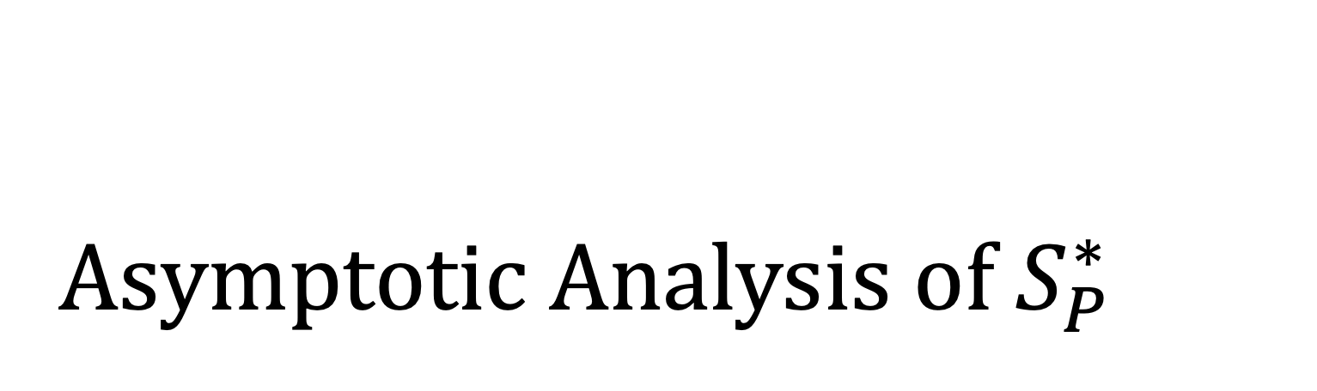
Asymptotic Analysis of $S_{P}^{∗}$

Slide 28

Put-Call Symmetry Relation
$$C\left(S, τ;K,r, δ\right)=P\left(K,τ;S,δ,r\right)$$
Intuition
Two assets A & B (Cash and Stock), with dividends $r$ and $δ$ respectively
Calls exchange $K of cash for 1 stock worth $S
Puts exchange 1 stock worth $S for $K of cash
By swapping role of stock and cash in puts, we obtain a symmetry

Slide 29


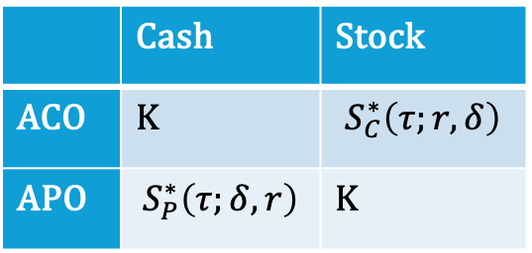
Put-Call Symmetry Relation for $S_{P|C}^{∗}$
We have $S_{C}^{∗}(τ;r, δ)$ and $S_{P}^{∗}\left(τ;r, δ\right):$
When $S=S_{C}^{∗}\left(τ;r,δ\right),$ACO exchanges $$K$ for 1 stock worth $$S_{C}^{∗}$
$\text{When} S=S_{P}^{∗}\left(τ;r,δ\right), \text{A}\text{P}\text{O} \text{exchanges}\text{ 1 }\text{stock} \text{worth}\text{ \$}S_{P}^{∗}$ for $K
Interchange role of stock and cash in $S_{P}^{∗}\left(τ;r,δ\right)$ → $S_{P}^{∗}\left(τ;δ,r\right)$
Exchanging K cash to stock and back gives
$K=\frac{S_{C}^{∗}\left(τ;r,δ\right)S_{P}^{∗}\left(τ;r,δ\right)}{K}$ or
$S_{C}^{∗}\left(τ;r,δ\right)=\frac{K^{2}}{S_{P}^{∗}\left(τ;δ,r\right)}$
 | Cash | Stock
ACO | K | $$S_{C}^{∗}\left(τ;r,δ\right)$$
APO | $$S_{P}^{∗}\left(τ;δ,r\right)$$ | K

Slide 30


Property Analysis of $S_{P}^{∗}$
Property 1:
For $S≤S_{P}^{∗}\left(τ\right)$, the option is exercised and $P\left(S,τ\right)=K−S$ is a lower bound for our put option
Continuation Region:
$\{\left(S,τ\right):S_{P}^{∗}<S<∞, 0<τ<T\}$
Property 2:
From $S_{C}^{∗}\left(τ;r,δ\right)=\frac{K^{2}}{S_{P}^{∗}\left(τ;δ,r\right)}$, we find that $S_{P}^{∗}\left(τ\right)$ is a continuous decreasing (increasing) function of $τ$ ($t$)

Slide 31


$S_{P}^{∗}$close to expiry ($τ→0^{+}$)
Finding $S_{P}^{∗}$ precisely is mathematically challenging
However, we can deduce a lower bound using put-call symmetry:
$$\lim_{τ→0^{+}}{S_{P}^{∗}\left(τ;r, δ\right)=\frac{K^{2}}{{\lim_{τ→0^{+}}S}_{C}^{∗}\left(τ;δ, r\right)}}=\frac{K^{2}}{K\max{(1,\frac{δ}{r})}}=K\min{(1,\frac{r}{δ})}$$
Aside:
When ($δ=0$), $S_{P}^{∗}\left(0^{+}\right)≠0$ and $S_{P}^{∗}(τ)$ is decreasing implies $S_{P}^{∗}\left(τ\right)≠0$ indicating it is always optimal to exercise even without dividends
When (r = 0), $S_{P}^{∗}\left(0^{+}\right)=0$ and $S_{P}^{∗}(τ)$ is decreasing implies $S_{P}^{∗}\left(τ\right)=0$ , indicating at nonpositive interest rate, it is never optimal to early exercise

Slide 32


$S_{P}^{∗}$infinite time to expiry ($τ→∞$)
The process is nearly identical to $S_{C, ∞}^{∗}$
$$P_{∞}\left(S;K , δ\right)=\frac{S_{P, ∞}^{∗}}{λ_{−}}{\left(\frac{S}{S_{P, ∞}^{∗}}\right)}^{λ_{−}}$$
$$S_{P, ∞}^{∗}=\frac{λ_{−}K}{λ_{−}−1}$$
$$λ_{−}=\frac{−\left(r−δ−\frac{1}{2}σ^{2}\right)−\sqrt{{\left(r−δ−\frac{1}{2}σ^{2}\right)}^{2}+2σ^{2}r}}{σ^{2}}$$

Slide 33
Discussion

Slide 34

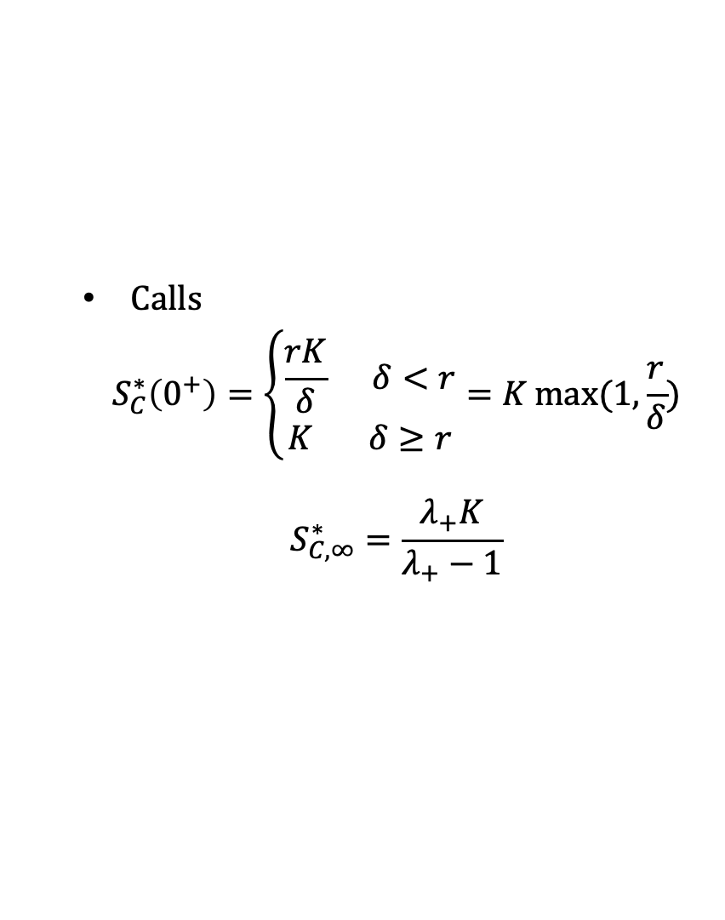
Conclusion
Free Boundary Value Problems are challenging to solve and typically require some level of domain knowledge to understand free boundary behavior
Summary of Asymptotes:
Calls
$$S_{C}^{∗}\left(0^{+}\right)=\left\{\begin{aligned}\frac{rK}{δ} δ<r \\ K δ≥r\end{aligned}\right.=K\max{(1,\frac{r}{δ})}$$
$$S_{C, ∞}^{∗}=\frac{λ_{+}K}{λ_{+}−1}$$
Puts
$$S_{P}^{∗}{\left(0^{+}\right)}^{−} =K\min{(1,\frac{r}{δ})}$$
$$S_{P, ∞}^{∗}=\frac{λ_{−}K}{λ_{−}−1}$$

